Slide 1
Business Understanding
Sutanuka Nayak
DSC46 –ID3543​

Slide 2
Objective
To study data and find patterns/symptoms/indicators that help us understand what people tend to become defaulters and save the banks to incur any loss

Slide 3
AGENDA
This case study aims to identify patterns which indicate if a client has difficulty paying their installments which may be used for taking actions such as denying the loan, reducing the amount of loan, lending (to risky applicants) at a higher interest rate, etc. This will ensure that the consumers capable of repaying the loan are not rejected. Identification of such applicants using EDA is the aim of this case study.
In other words, the company wants to understand the driving factors (or driver variables) behind loan default, i.e. the variables which are strong indicators of default. The company can utilize this knowledge for its portfolio and risk assessment.

Slide 4



We used 3 datasets
application_data.csv
previous_application.csv'
columns_description.csv
contains all the information of the client at the time of application. The data is about whether a client has payment difficulties.
contains information about the client’s previous loan data. It contains the data whether the previous application had been Approved, Cancelled, Refused or Unused offer.
is data dictionary which describes the meaning of the variables.

Slide 5
Introduction
This case study aims to give you an idea of applying EDA in a real business scenario. In this case study, apart from applying the techniques that you have learnt in the EDA module, you will also develop a basic understanding of risk analytics in banking and financial services and understand how data is used to minimize the risk of losing money while lending to customers.

Slide 6
PRIMARY GOALS
Uploading the datasets.
Screening the data to check for outliers and missing values
Replacing the null values with the preferred methods using numerical and categorical methods
Performing few Univariate and Bivariate analysis
Performing correlation functions
Final analysis

Slide 7
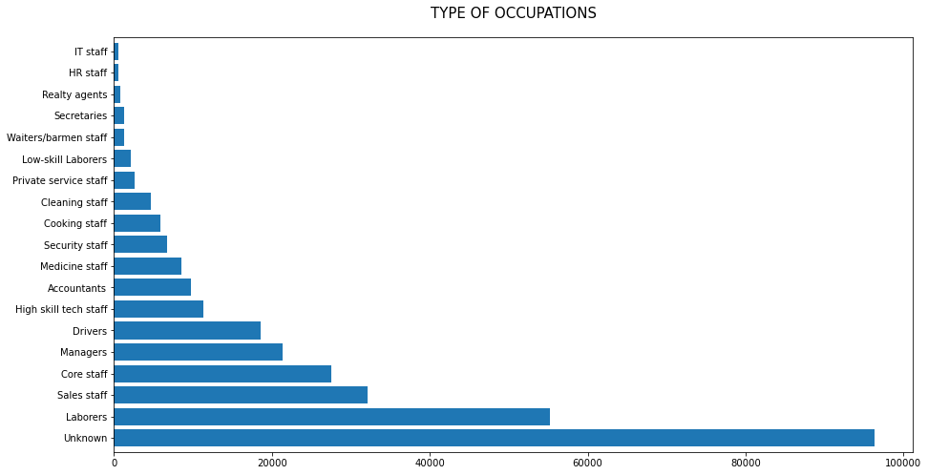

Slide 8
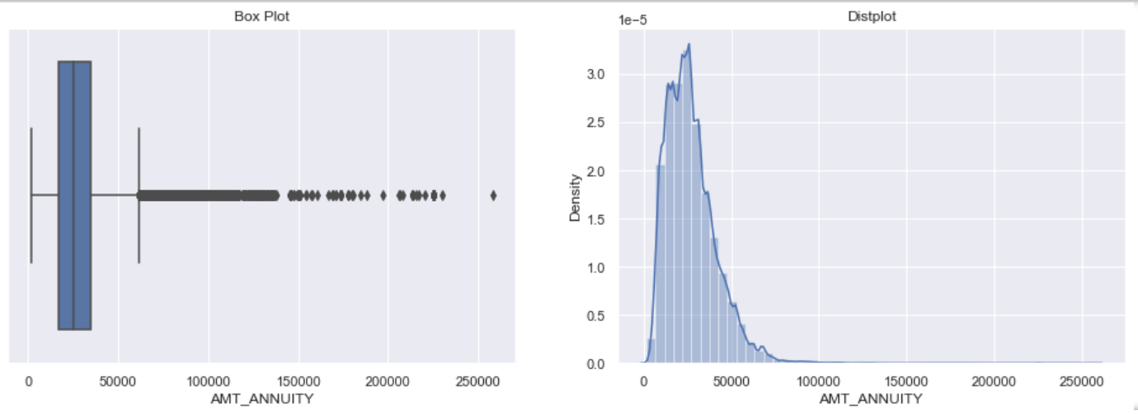
Some outliers are noticed in annuity amount.
The first quartile is bigger than third quartile for annuity amount which means most of the annuity clients are from first quartile.

Slide 9
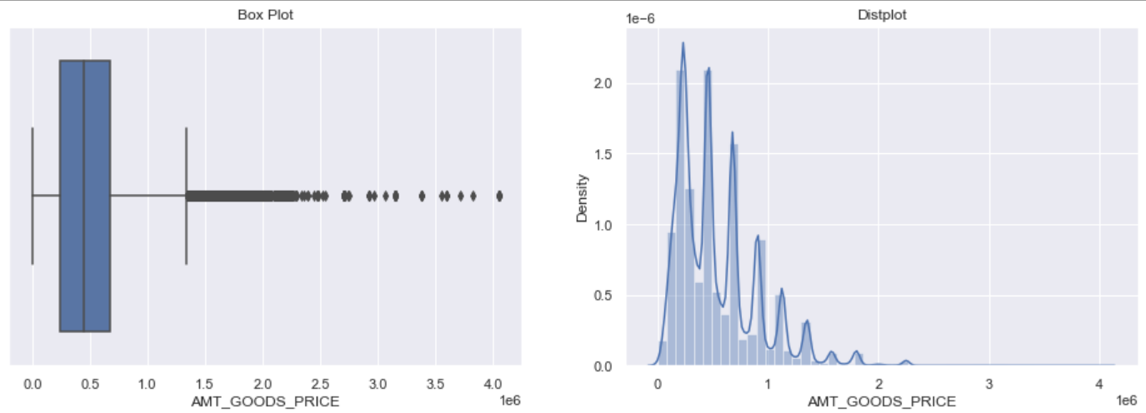

Slide 10
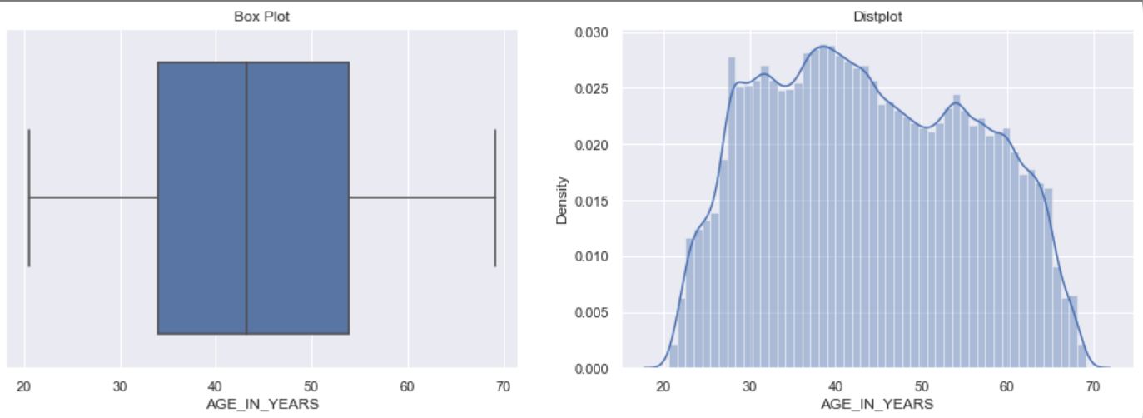

Slide 11
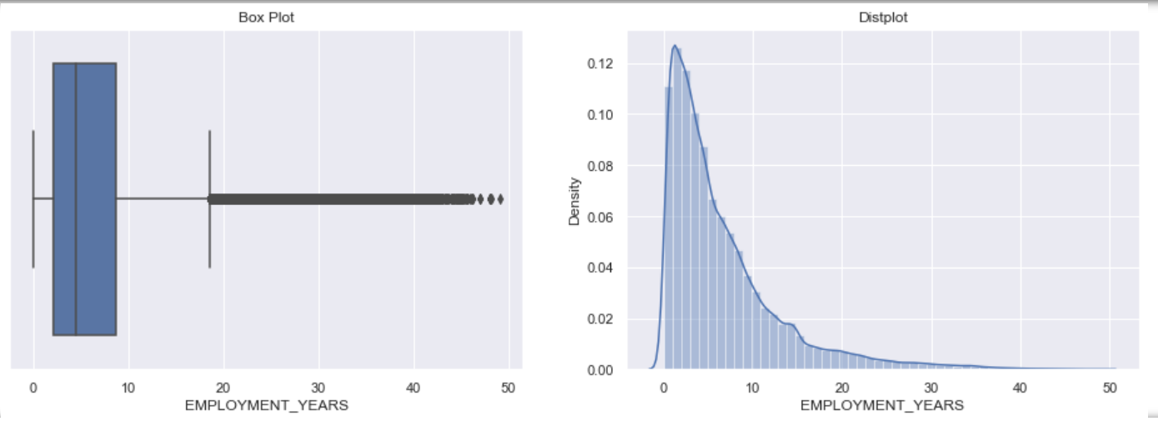

Slide 12
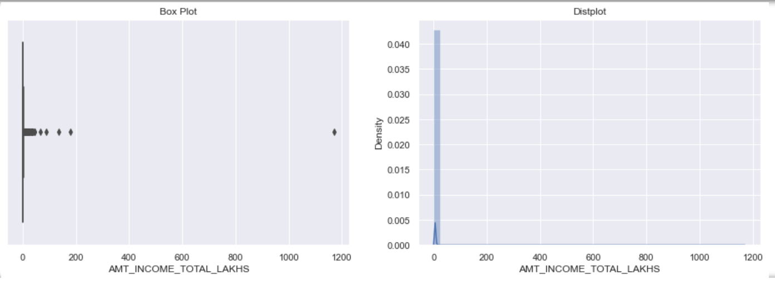

Slide 13
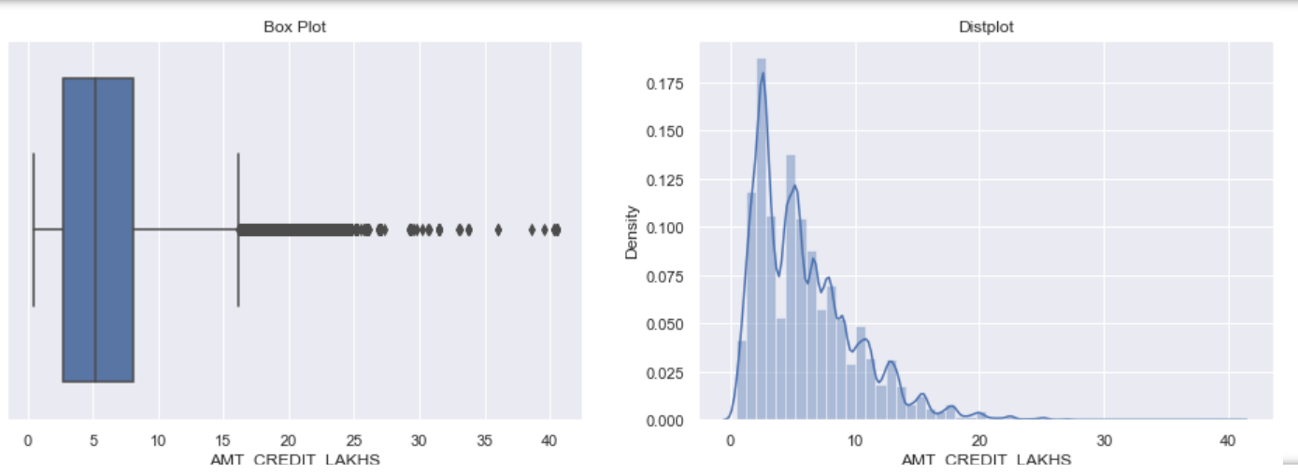

Slide 14
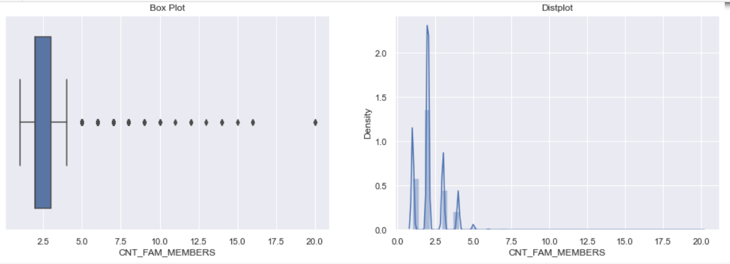

Slide 15
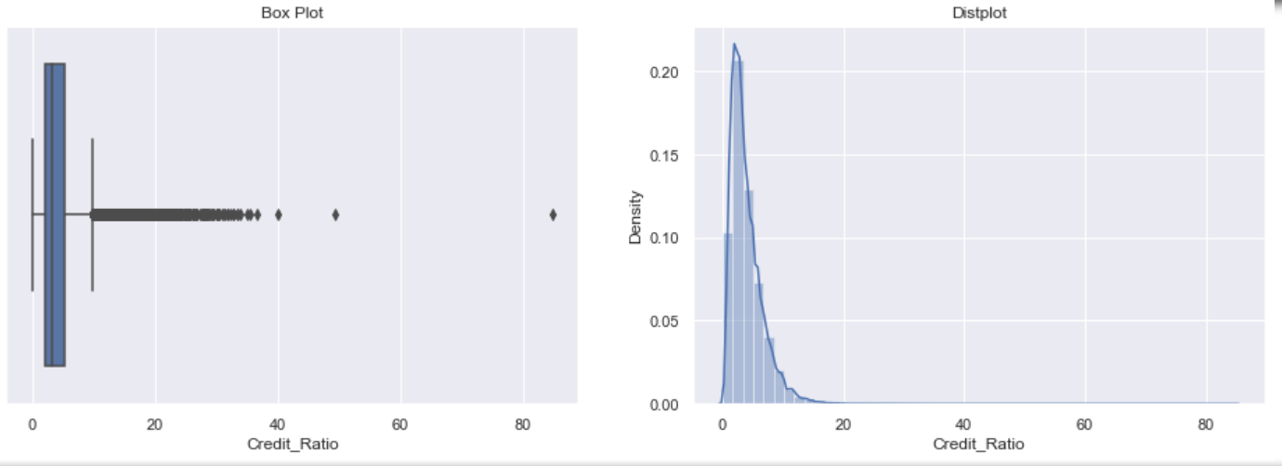

Slide 16
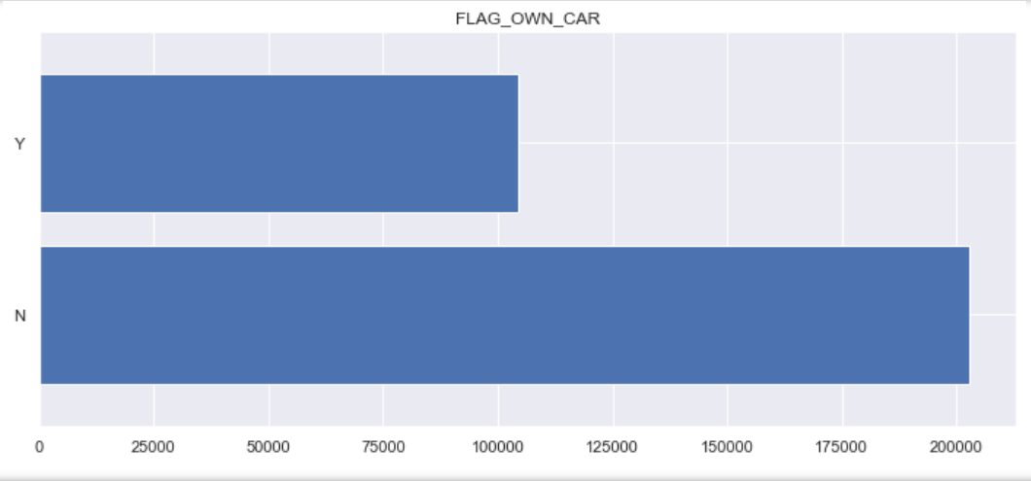

Slide 17
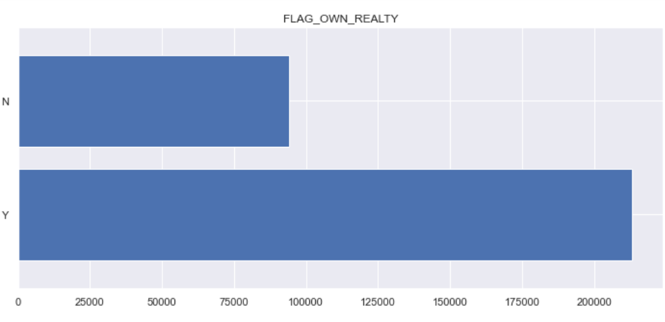

Slide 18
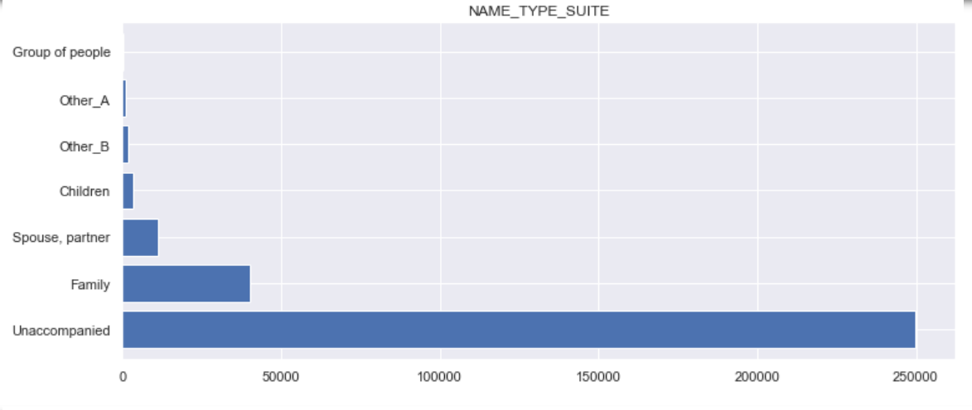

Slide 19
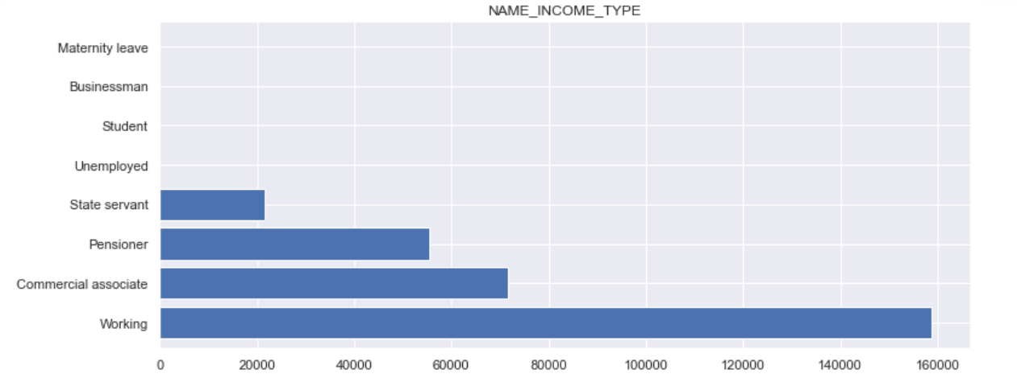

Slide 20
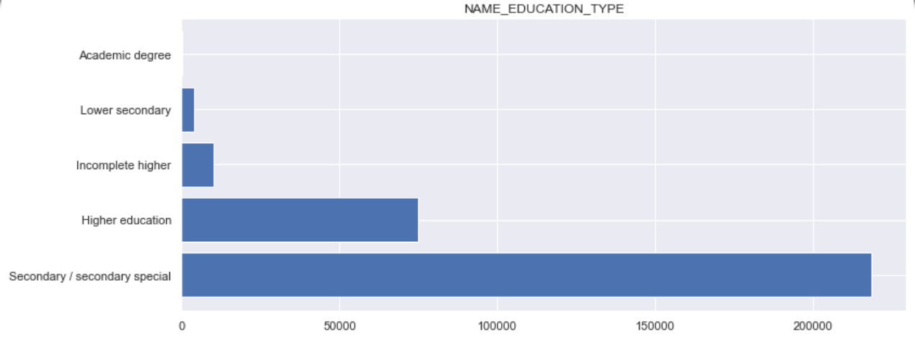

Slide 21
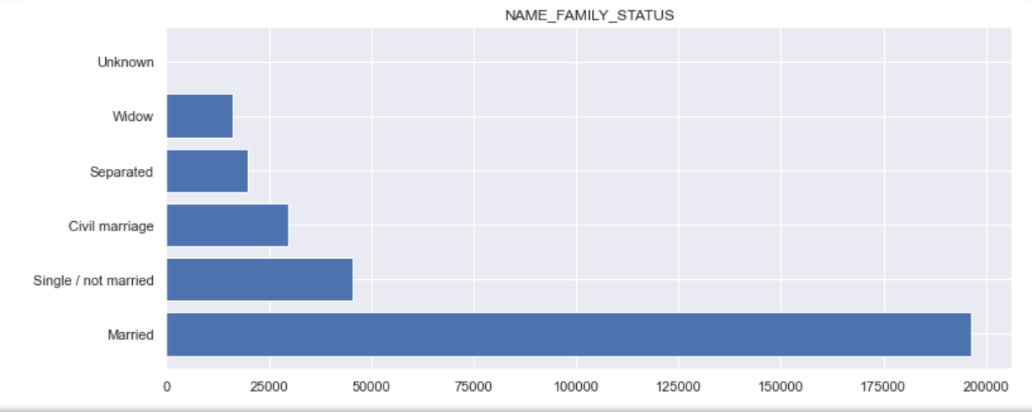

Slide 22
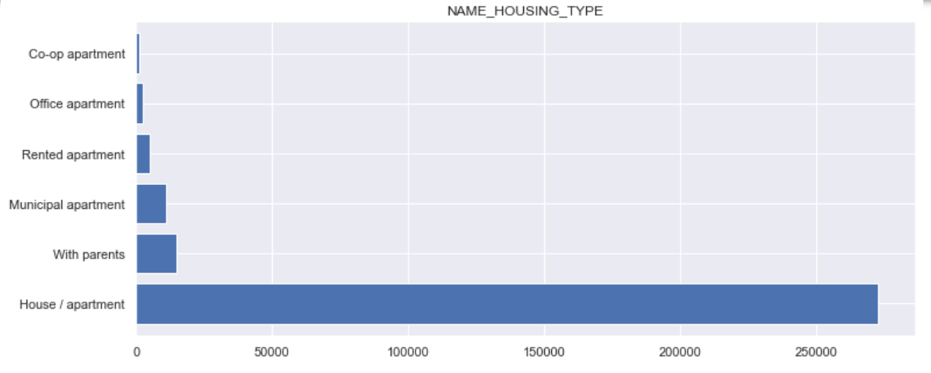

Slide 23
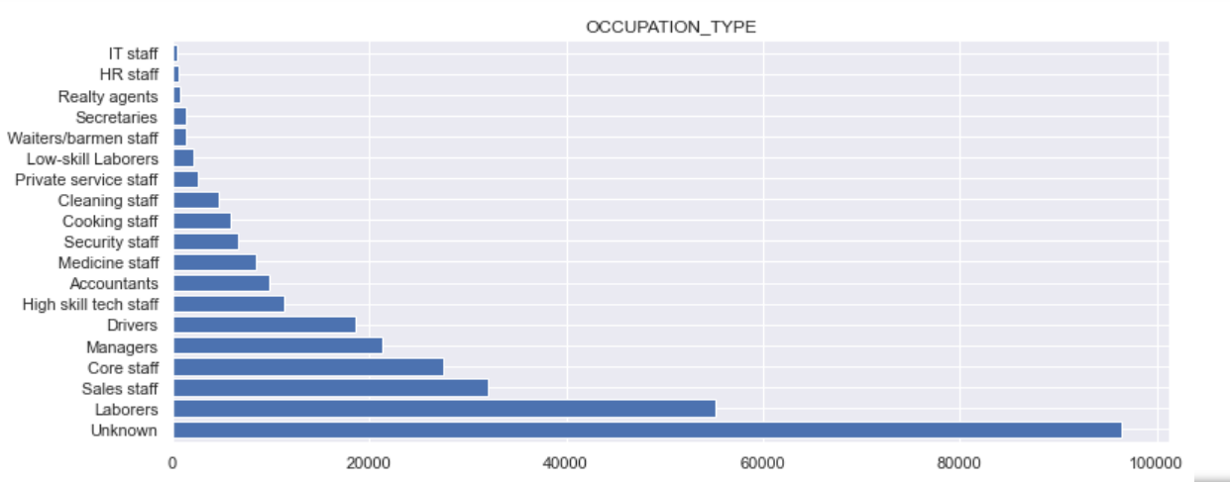

Slide 24
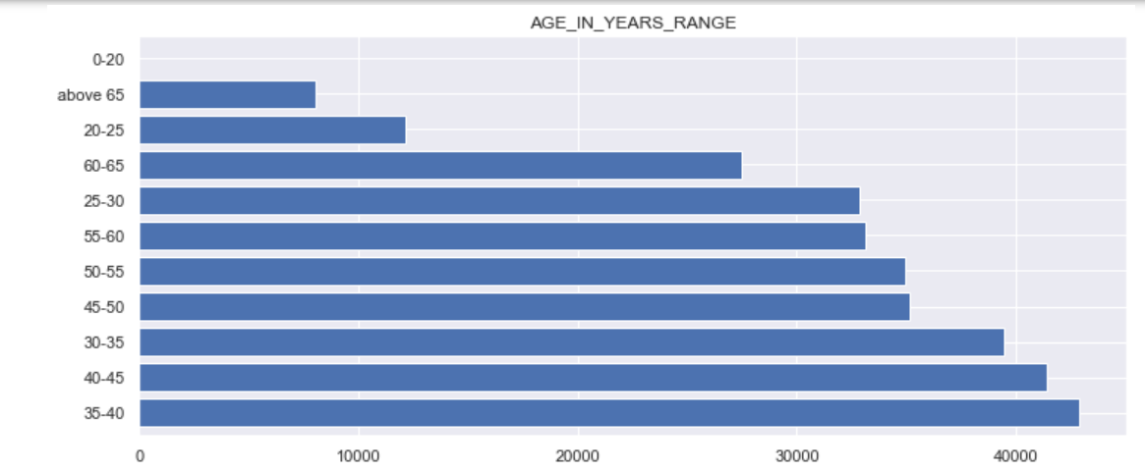

Slide 25
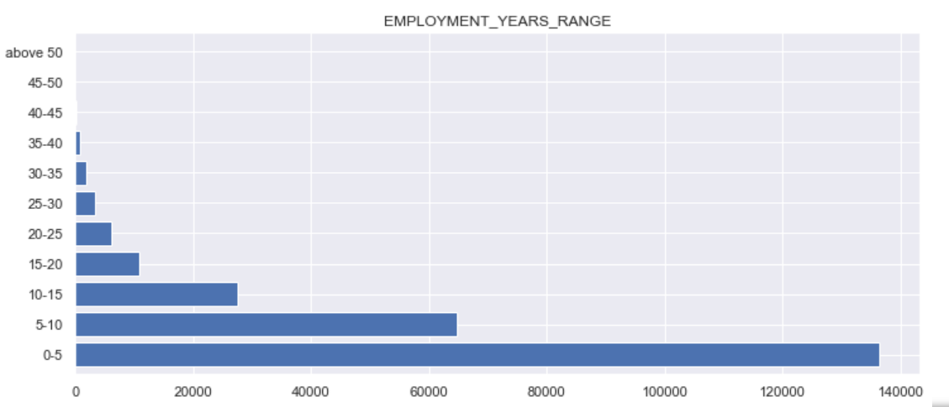

Slide 26
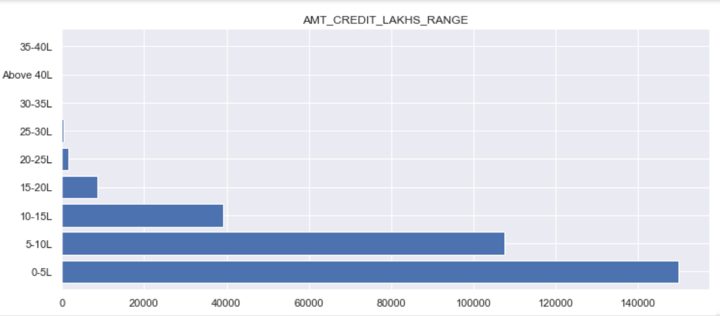

Slide 27
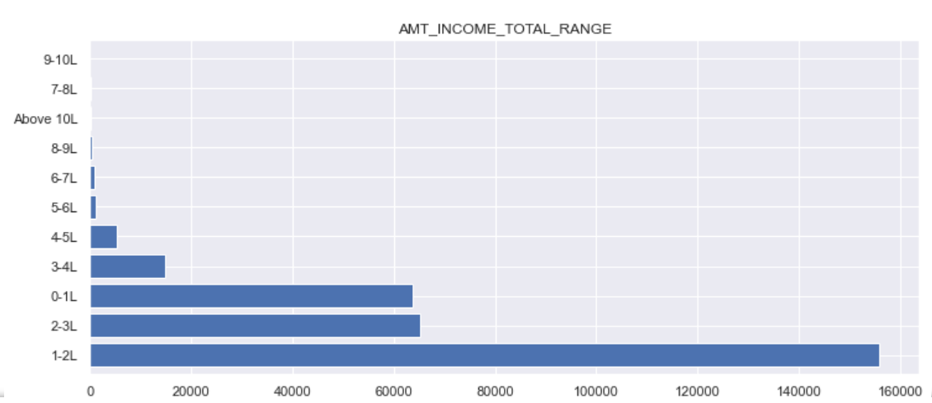

Slide 28
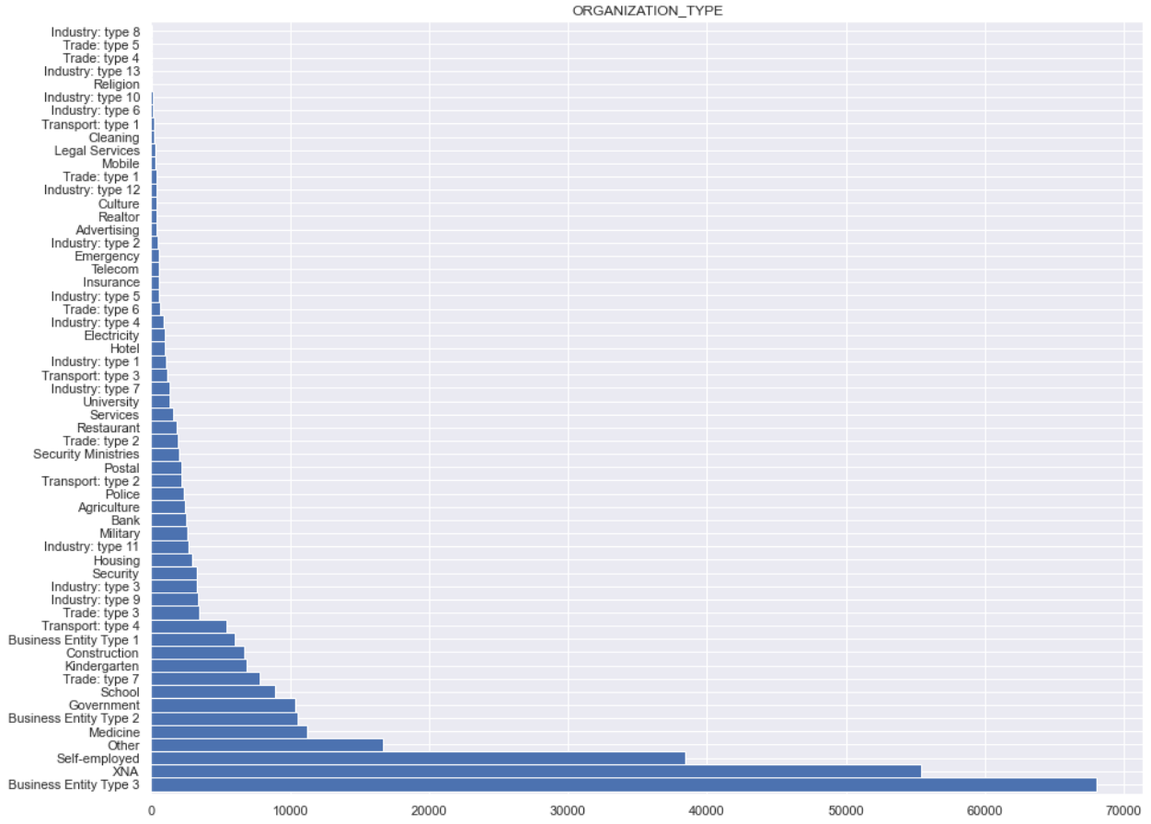

Slide 29
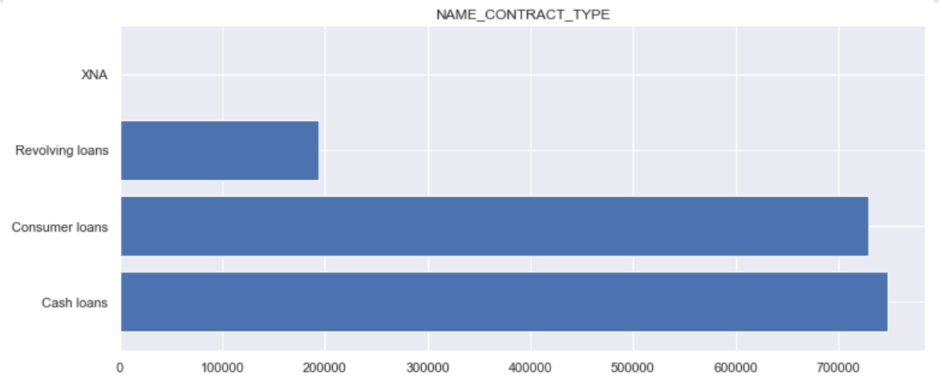

Slide 30
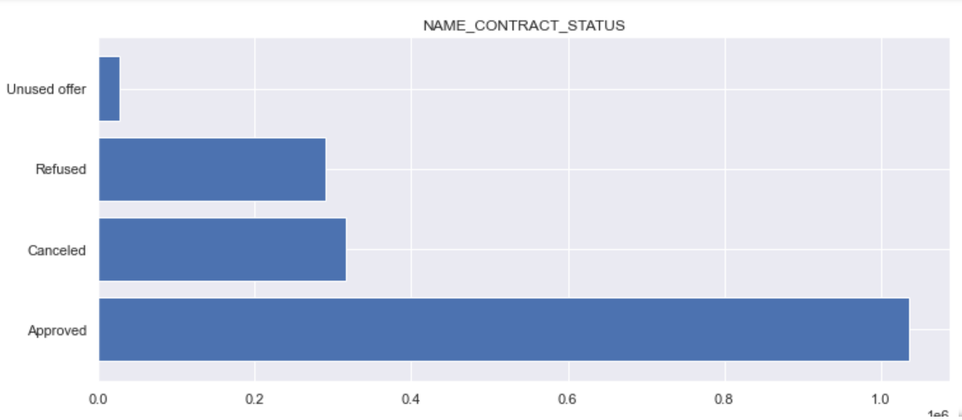

Slide 31
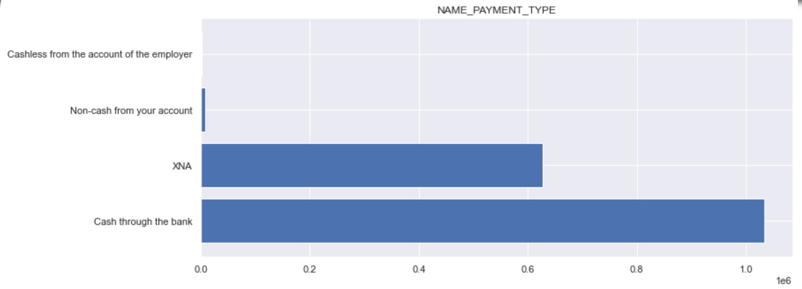

Slide 32
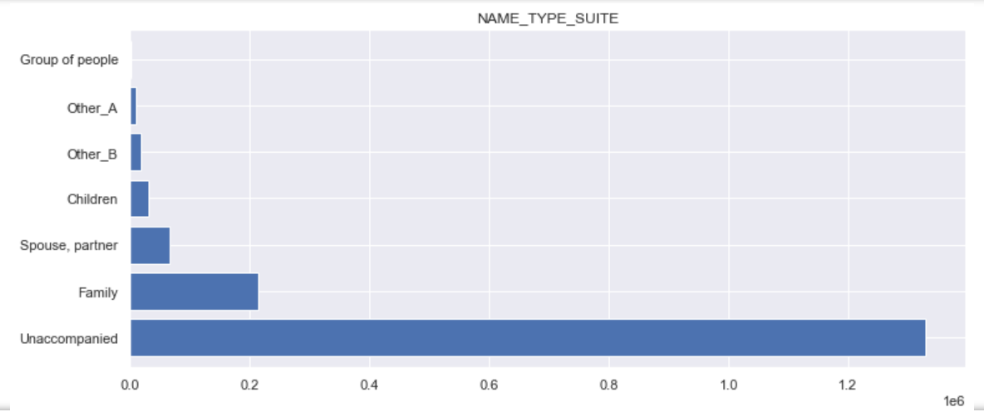

Slide 33
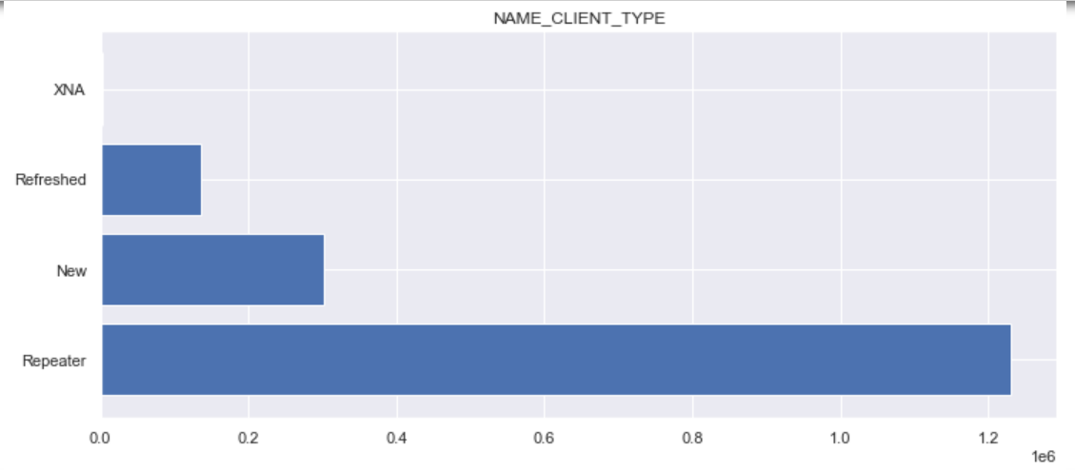

Slide 34
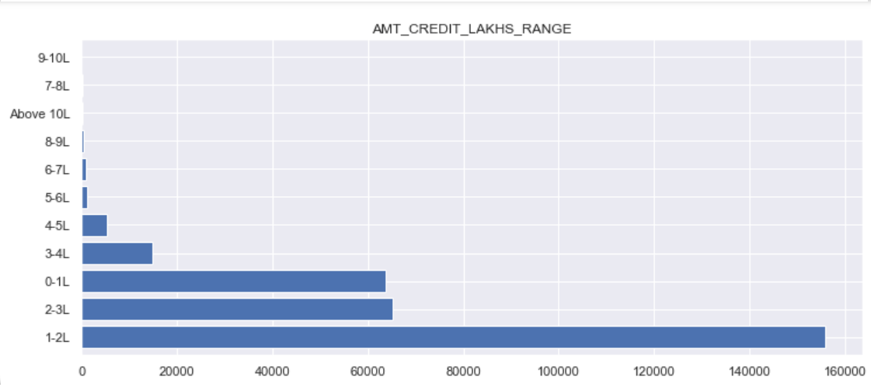

Slide 35
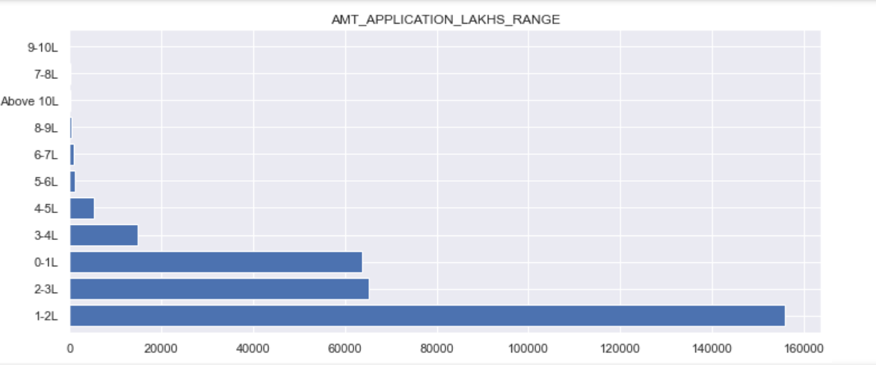

Slide 36
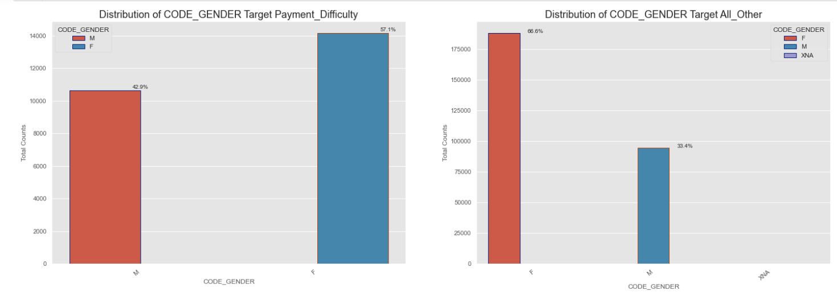

Slide 37
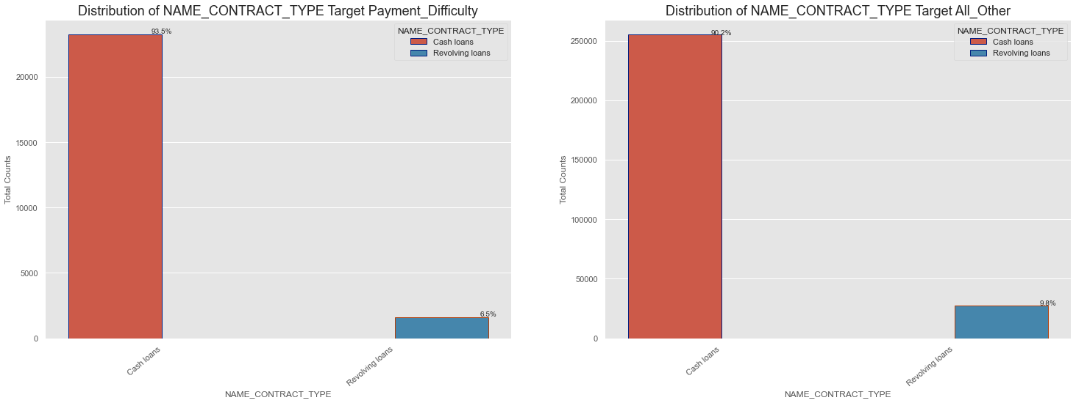

Slide 38
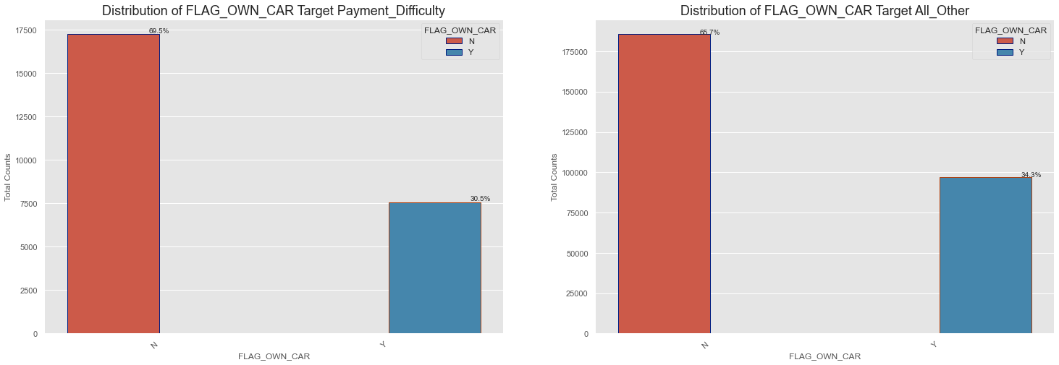

Slide 39
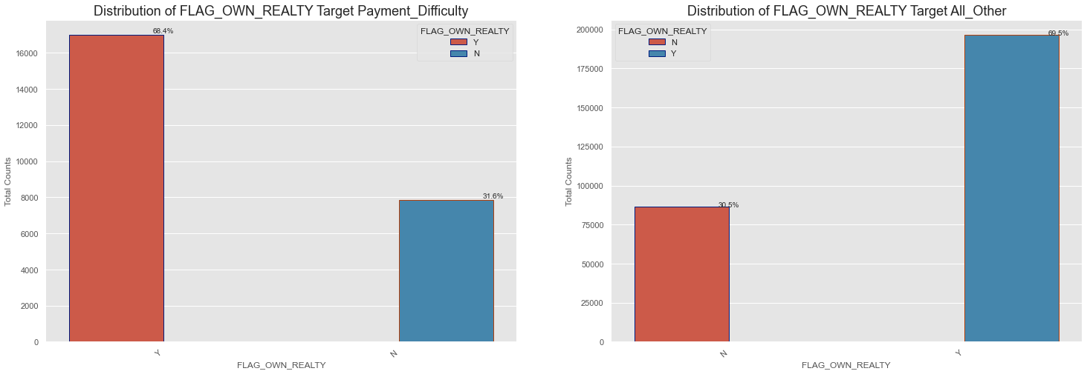

Slide 40
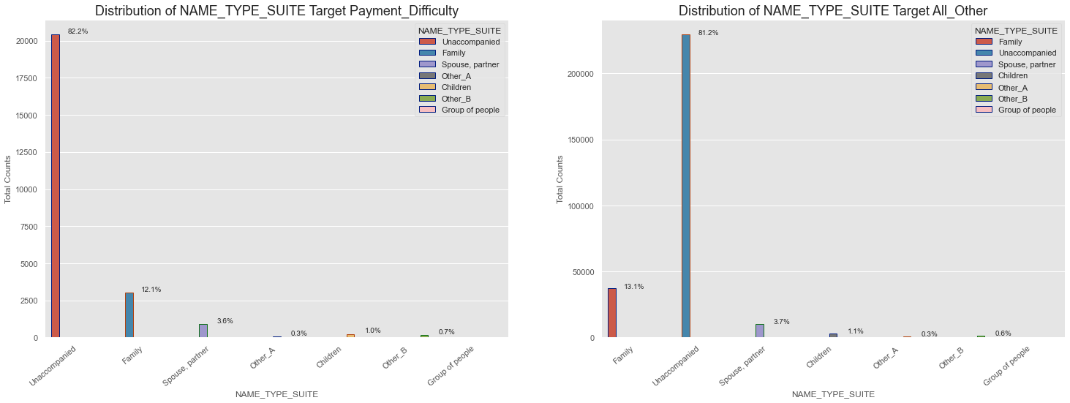

Slide 41
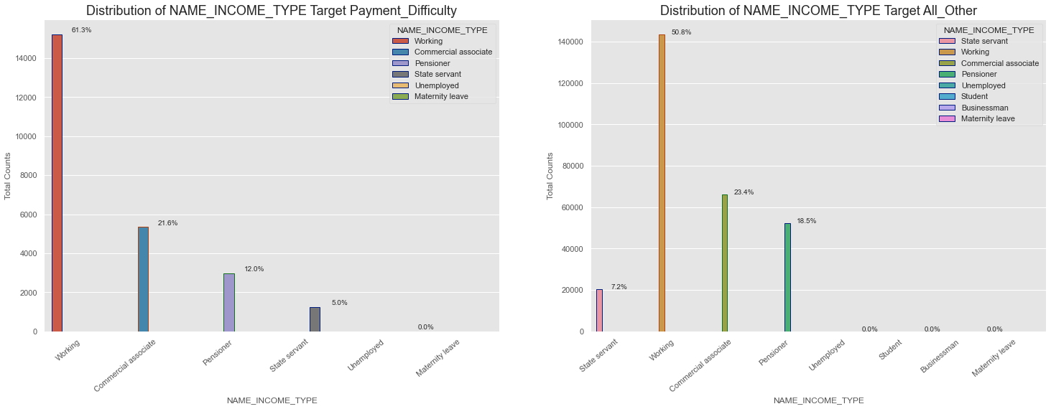

Slide 42
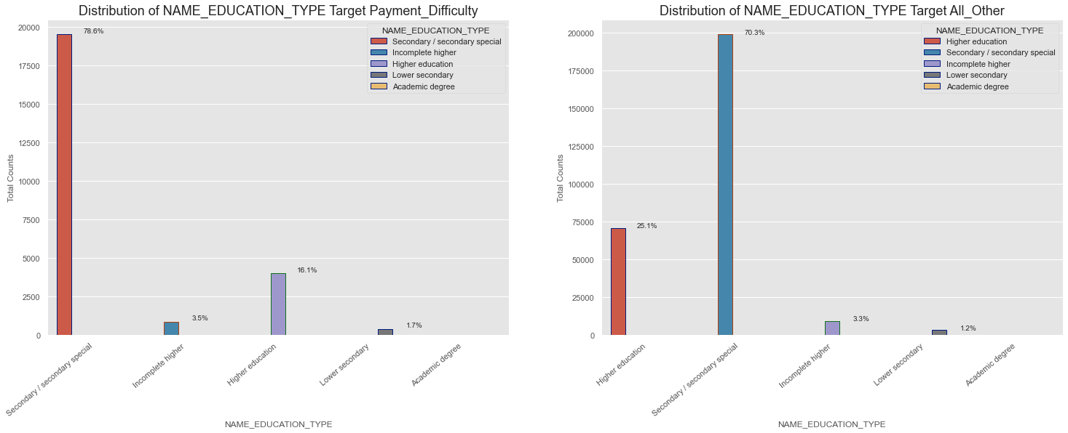

Slide 43
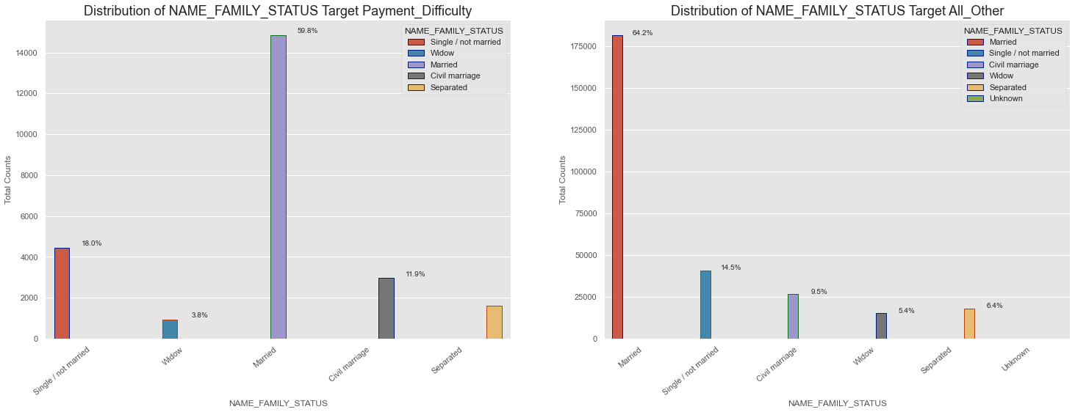

Slide 44
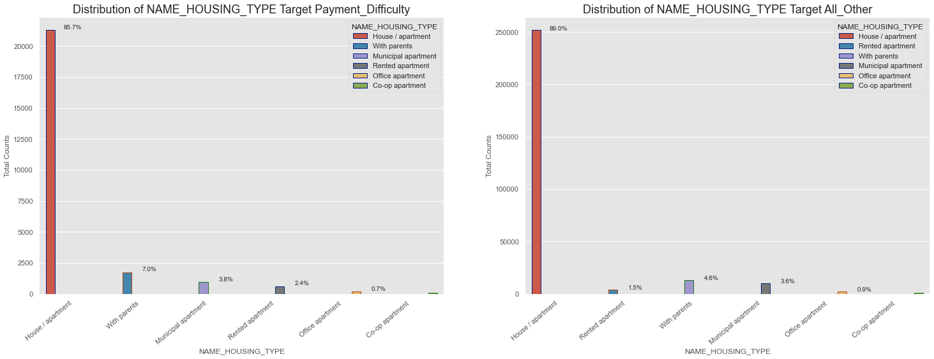

Slide 45
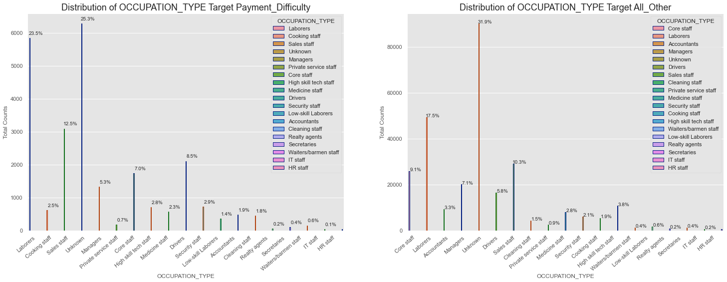

Slide 46
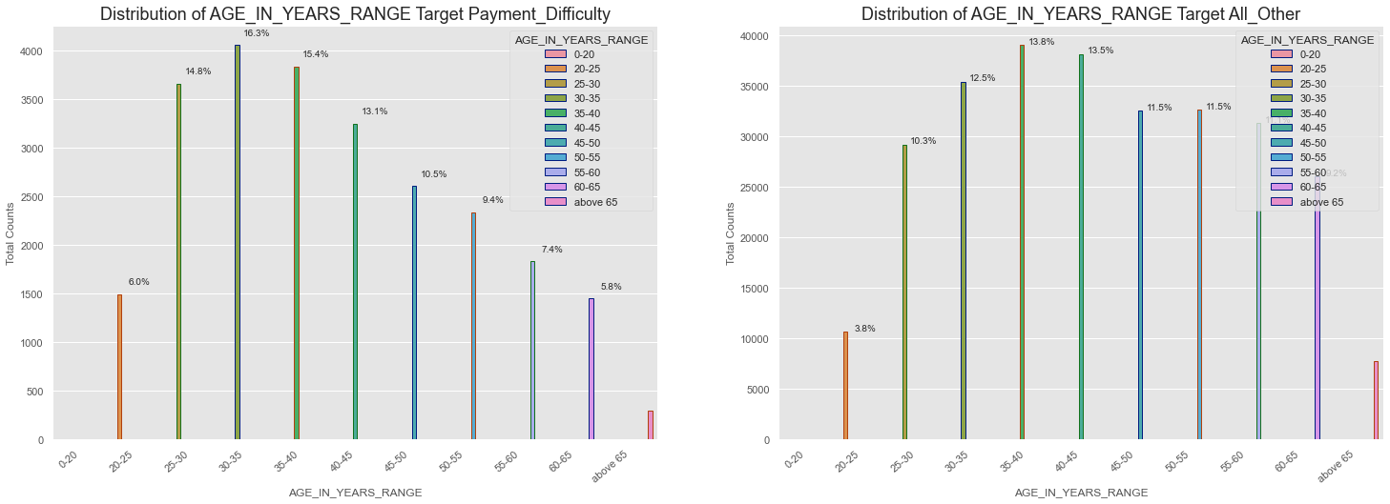

Slide 47
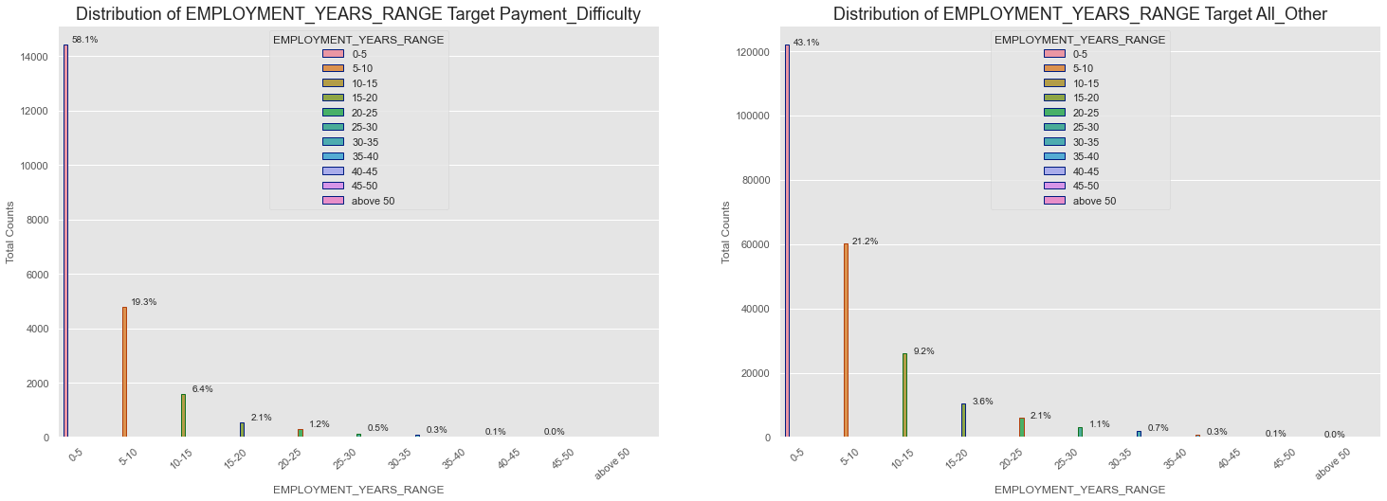

Slide 48
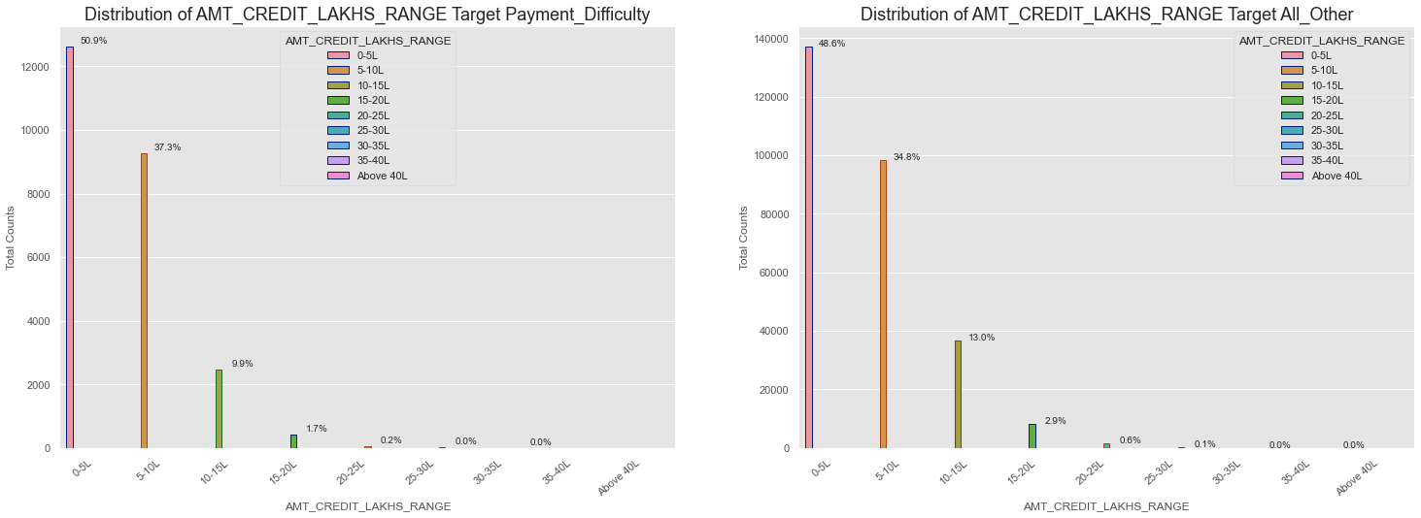

Slide 49
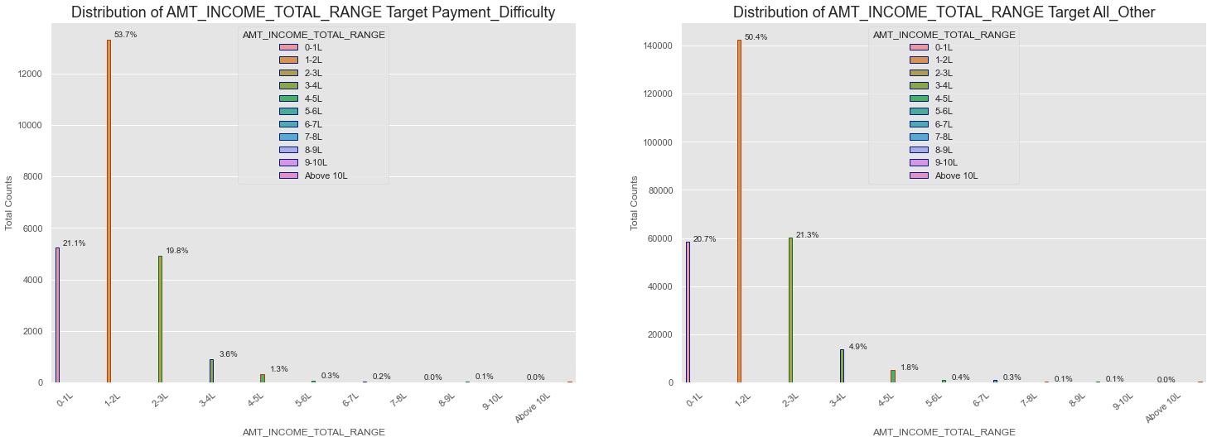

Slide 50
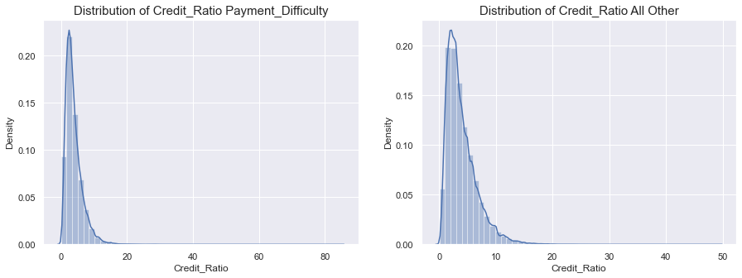

Slide 51
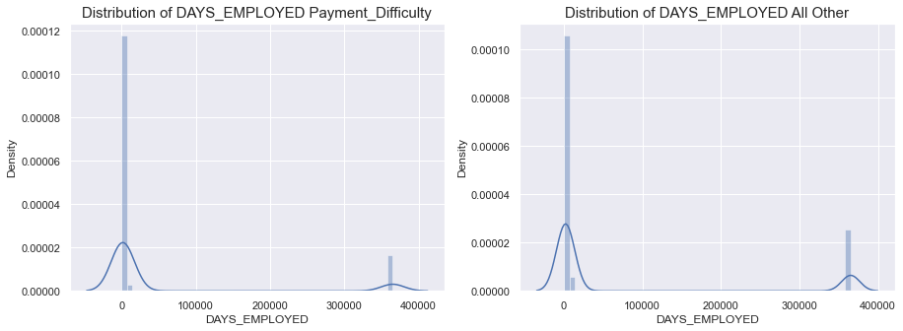

Slide 52
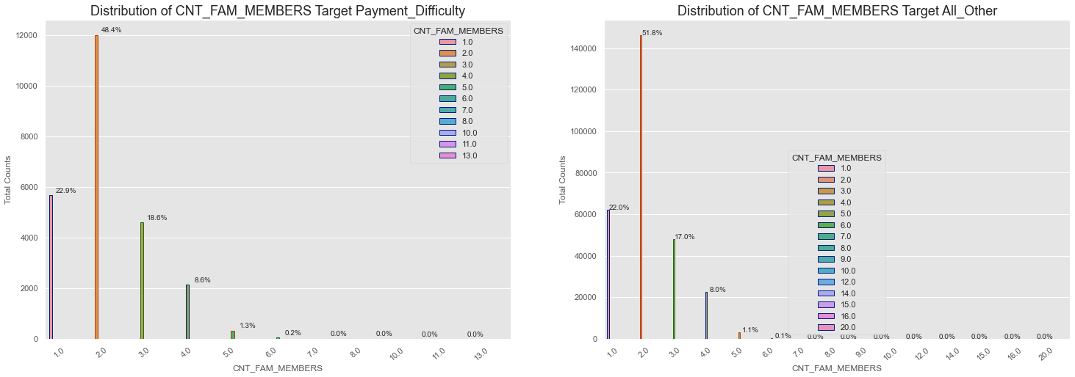

Slide 53
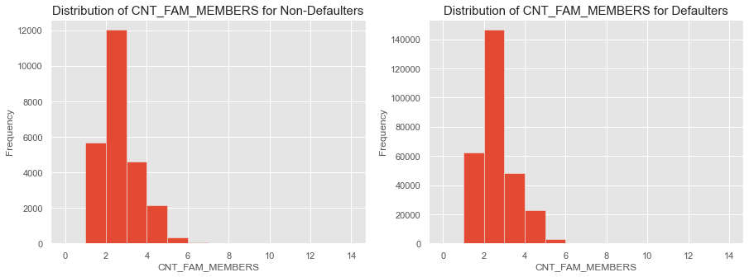

Slide 54
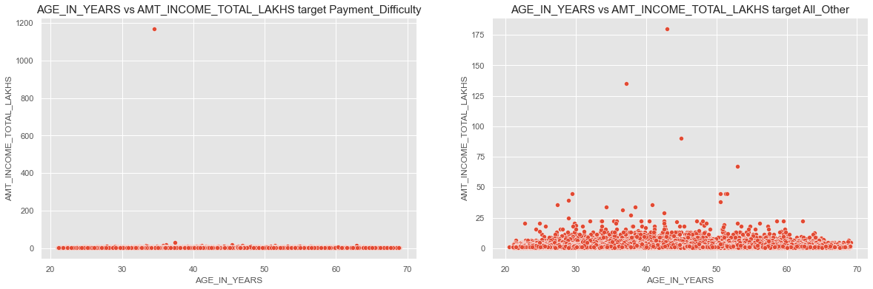

Slide 55
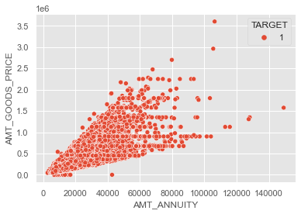

Slide 56
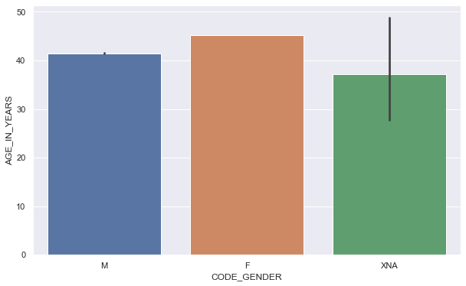

Slide 57


Slide 58

Correlation for target 0

Slide 59
inference
Points to be concluded from the graph presented before.
Credit amount is inversely proportional to the date of birth, which means it is higher for lower age and vice-versa.
Credit amount is inversely proportional to the number of children client have, means Credit amount is higher for less children count client have and vice-versa.
Income amount is inversely proportional to the number of children client have, means more income for less children client have and vice-versa.
less children client have in densely populated area.
Credit amount is higher to densely populated area.
The income is also higher in densely populated area.

Slide 60

Correlation for target 1

Slide 61
inference
This heat map for Target 1 is also having quite a same observation just like Target 0. But for few points are different. They are listed below.
The client's permanent address does not match contact address are having less children and vice-versa
The client's permanent address does not match work address are having less children and vice-versa

Slide 62
AREAS OF FOCUS
Banks should focus more on contract type ‘Student’ ,’pensioner’ and ‘Businessman’ with housing ‘type other than ‘Co-op apartment’ for successful payments.
Banks should focus less on income type ‘Working’ as they are having most number of unsuccessful payments.
Also with loan purpose ‘Repair’ is having higher number of unsuccessful payments on time.
Get as much as clients from housing type ‘With parents’ as they are having least number of unsuccessful payments.

Slide 63
After performing the univariate analysis:
Most rejection of loans came from purpose 'repairs'.
For education purposes we have equal number of approves and rejection
Paying other loans and buying a new car is having significant higher rejection than approves
Loan purposes with 'Repairs' are facing more difficulties in payment on time.
There are few places where loan payment is significant higher than facing difficulties. They are 'Buying a garage', 'Business development', 'Buying land’, 'Buying a new car' and 'Education' Hence we can focus on these purposes for which the client is having for minimal payment difficulties.
After performing the Bivariate analysis:
The credit amount of Loan purposes like 'Buying a home’, ’Buying a land’, 'Buying a new car' and ‘Building a house' is higher.
Income type of state servants have a significant amount of credit applied
Money for third person or a Hobby is having less credits applied for

Slide 64
Areas of
Banks should focus more on contract type ‘Student’ ,’pensioner’ and ‘Businessman’ with housing ‘type other than ‘Co-op apartment’ for successful payments.
Banks should focus less on income type ‘Working’ as they are having most number of unsuccessful payments.
Also with loan purpose ‘Repair’ is having higher number of unsuccessful payments on time.
Get as much as clients from housing type ‘With parents’ as they are having least number of unsuccessful payments.

Slide 65
THANK YOU

